Slide 1
The Sustained Patient-centered Alcohol-Related Care (SPARC) Trial:
A cluster-randomized implementation trial in primary care
Katharine A. Bradley, MD, MPH
Carol Achtmeyer, ARNP, MN
Julie Richards, PhD, MPH
Dissemination and Implementation Conference 2019
Washington DC
Notes:
Hello and welcome everyone to our symposium, The Sustained Patient-centered Alcohol-Related Care (SPARC) Trial: A cluster-randomized implementation trial in primary care.

Slide 2
Thanks to:
Collaborators
Research Funding
Amy K. Lee, MPH
Jennifer F. Bobb, PhD
Evette J. Ludman, PhD
Emily C. Williams, PhD, MPH
Malia Oliver
Chester Pabiniak
Ryan M. Caldeiro, MD
Rebecca Parrish, LICSW, MSW
Joseph E. Glass, PhD, MSW
Tessa Matson, MPH
Paula Lozano, MD, MPH
  Agency for Healthcare Research and Quality (AHRQ) R18 HS023173 - SPARC Trial
  NIAAA K24 AA022128 (Bradley)
  NIAAA K01 AA023859 (Glass)
AHRQ – R18 HS027076 Michigan SPARC (Bradley/Day)
Notes:
First I’d like to thank our collaborators, and our research funding and support, specifically the Agency for Healthcare Research and Quality which funded our main SPARC trial and analyses.

Slide 3
Overview
Introduction: Overview
Aim 1 – Achtmeyer
Aim 2 – Bradley
Sustainability – Richards
Notes:
So for today’s presentations, I will be sharing more about the enhanced model of practice coaching used in our trial; Dr. Bradley will debut our main trial results, and Dr. Williams will present on a secondary evaluation of the SPARC implementation intervention describing patient-reported alcohol advice

Slide 4
Overview

Slide 5
Spectrum Unhealthy Alcohol Use
Moderate-severe
DSM-5 AUD
Preventive
Counseling
For
Unhealthy
Alcohol Use
Mild
DSM-5 AUD
> Recommended
limits
< Recommended limits
Notes:
K. Bradley
6/22/2023
Alcohol Screening & Brief Intervention in Women
5
30% AUD in lifetime
8-15% past year

Slide 6
SPARC Trial: Specific Aims
To evaluate whether the SPARC intervention increased the proportion of PC patients who:
Had a positive screen for unhealthy alcohol use and brief alcohol counseling documented in their EHR
Had new alcohol use disorder (AUD) diagnosed with subsequent initiation and engagement in alcohol treatment
Secondarily to achieve both aims in a manner that would be sustained.
Notes:
The SPARC trial had two main aims. The first was to increase the proportion of primary care patients who have unhealthy alcohol use identified and brief intervention offered. The second aim was to increase the proportion of primary care patients who have an alcohol use disorder recognized and are engaged in alcohol-related care , as defined by the National Committee for Quality Assurance (or NCQA), an organization that develops quality measures for health systems.

Slide 7
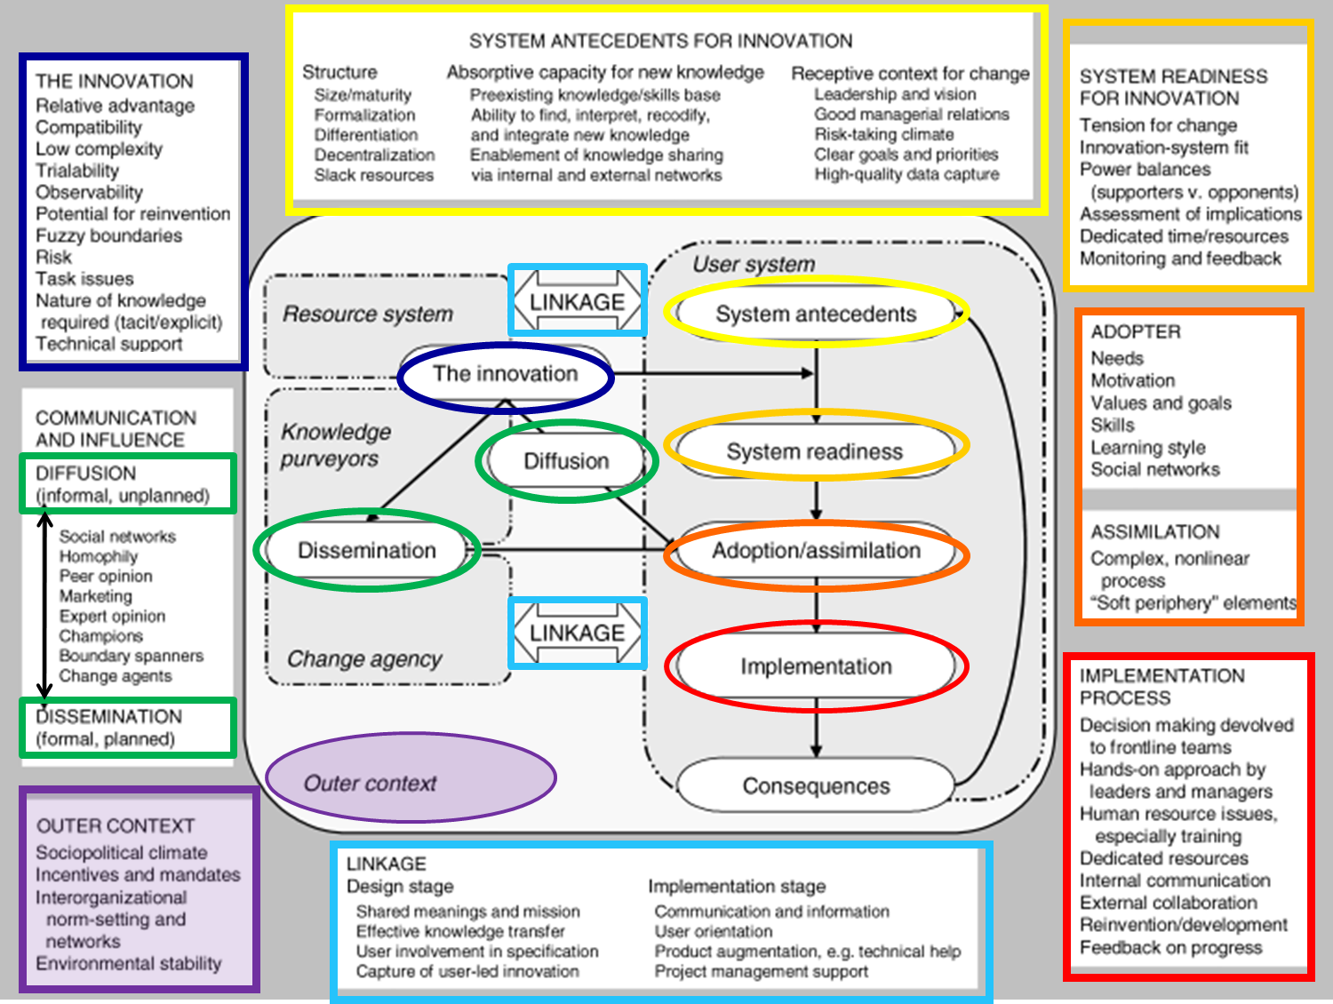
Greenhalgh
Model
  T. Greenhalgh
  Milbank Quarterly
  2004
Notes:
The trial took place in Kaiser Permanente Washington from January 2015 through July 2018. Implementation strategies included practice coaching, electronic health record (EHR) clinical decision support, and performance monitoring and feedback to local implementation teams. The sample included all patients seen for primary care across 25 sites during the study period . All measures relied on secondary data from EHR or insurance claims. The main outcome measure for prevention was documented brief intervention (BI) within 14 days of a positive AUDIT-C screen. Natural language processing and procedure codes were used to identify documented BI. The main outcome measure for AUD treatment was initiation and engagement in treatment, defined based on the US National Committee of Quality Assurance Healthcare Effectiveness Dataset Information System measures , requiring a visit with an AUD diagnosis within 14 days of initial diagnosis, with 2 more visits in the next 30 days . Analyses were conducted consistent with CONSORT for cluster-randomized trials (including intention to treat). We used general linear mixed models accounting for correlation of measures in the same person or site, adjusted for age, gender, race, ethnicity, ETC.
Edit if results are only 22 randomized clinisc
22?
Delete?
Delete this whole citation/source clause, not strictly necessary?
Or if required to keep source, (and I know this is sacrilegious) shorten to some combo such as:
US National Committee of Quality Assurance measures (skips HEDIS)
US Healthcare Effectiveness Dataset Information System (skip NCQA)
Should this be ‘for’? I’m not sure what is meant by ‘requiring a visit with an AUD diagnosis’
Or delete/shorten! 😊
“requiring a visit within 14 days of initial AUD diagnosis”
May not fit

Slide 8
SPARC Trial: Setting
Pragmatic primary care implementation trial
January 2015 - July 2018
Kaiser Permanente Washington
  Bobb IJERPH 2017; Glass Implementation Science 2018
Notes:
The trial took place in Kaiser Permanente Washington from January 2015 through July 2018. Implementation strategies included practice coaching, electronic health record (EHR) clinical decision support, and performance monitoring and feedback to local implementation teams. The sample included all patients seen for primary care across 25 sites during the study period . All measures relied on secondary data from EHR or insurance claims. The main outcome measure for prevention was documented brief intervention (BI) within 14 days of a positive AUDIT-C screen. Natural language processing and procedure codes were used to identify documented BI. The main outcome measure for AUD treatment was initiation and engagement in treatment, defined based on the US National Committee of Quality Assurance Healthcare Effectiveness Dataset Information System measures , requiring a visit with an AUD diagnosis within 14 days of initial diagnosis, with 2 more visits in the next 30 days . Analyses were conducted consistent with CONSORT for cluster-randomized trials (including intention to treat). We used general linear mixed models accounting for correlation of measures in the same person or site, adjusted for age, gender, race, ethnicity, ETC.
Edit if results are only 22 randomized clinisc
22?
Delete?
Delete this whole citation/source clause, not strictly necessary?
Or if required to keep source, (and I know this is sacrilegious) shorten to some combo such as:
US National Committee of Quality Assurance measures (skips HEDIS)
US Healthcare Effectiveness Dataset Information System (skip NCQA)
Should this be ‘for’? I’m not sure what is meant by ‘requiring a visit with an AUD diagnosis’
Or delete/shorten! 😊
“requiring a visit within 14 days of initial AUD diagnosis”
May not fit

Slide 9
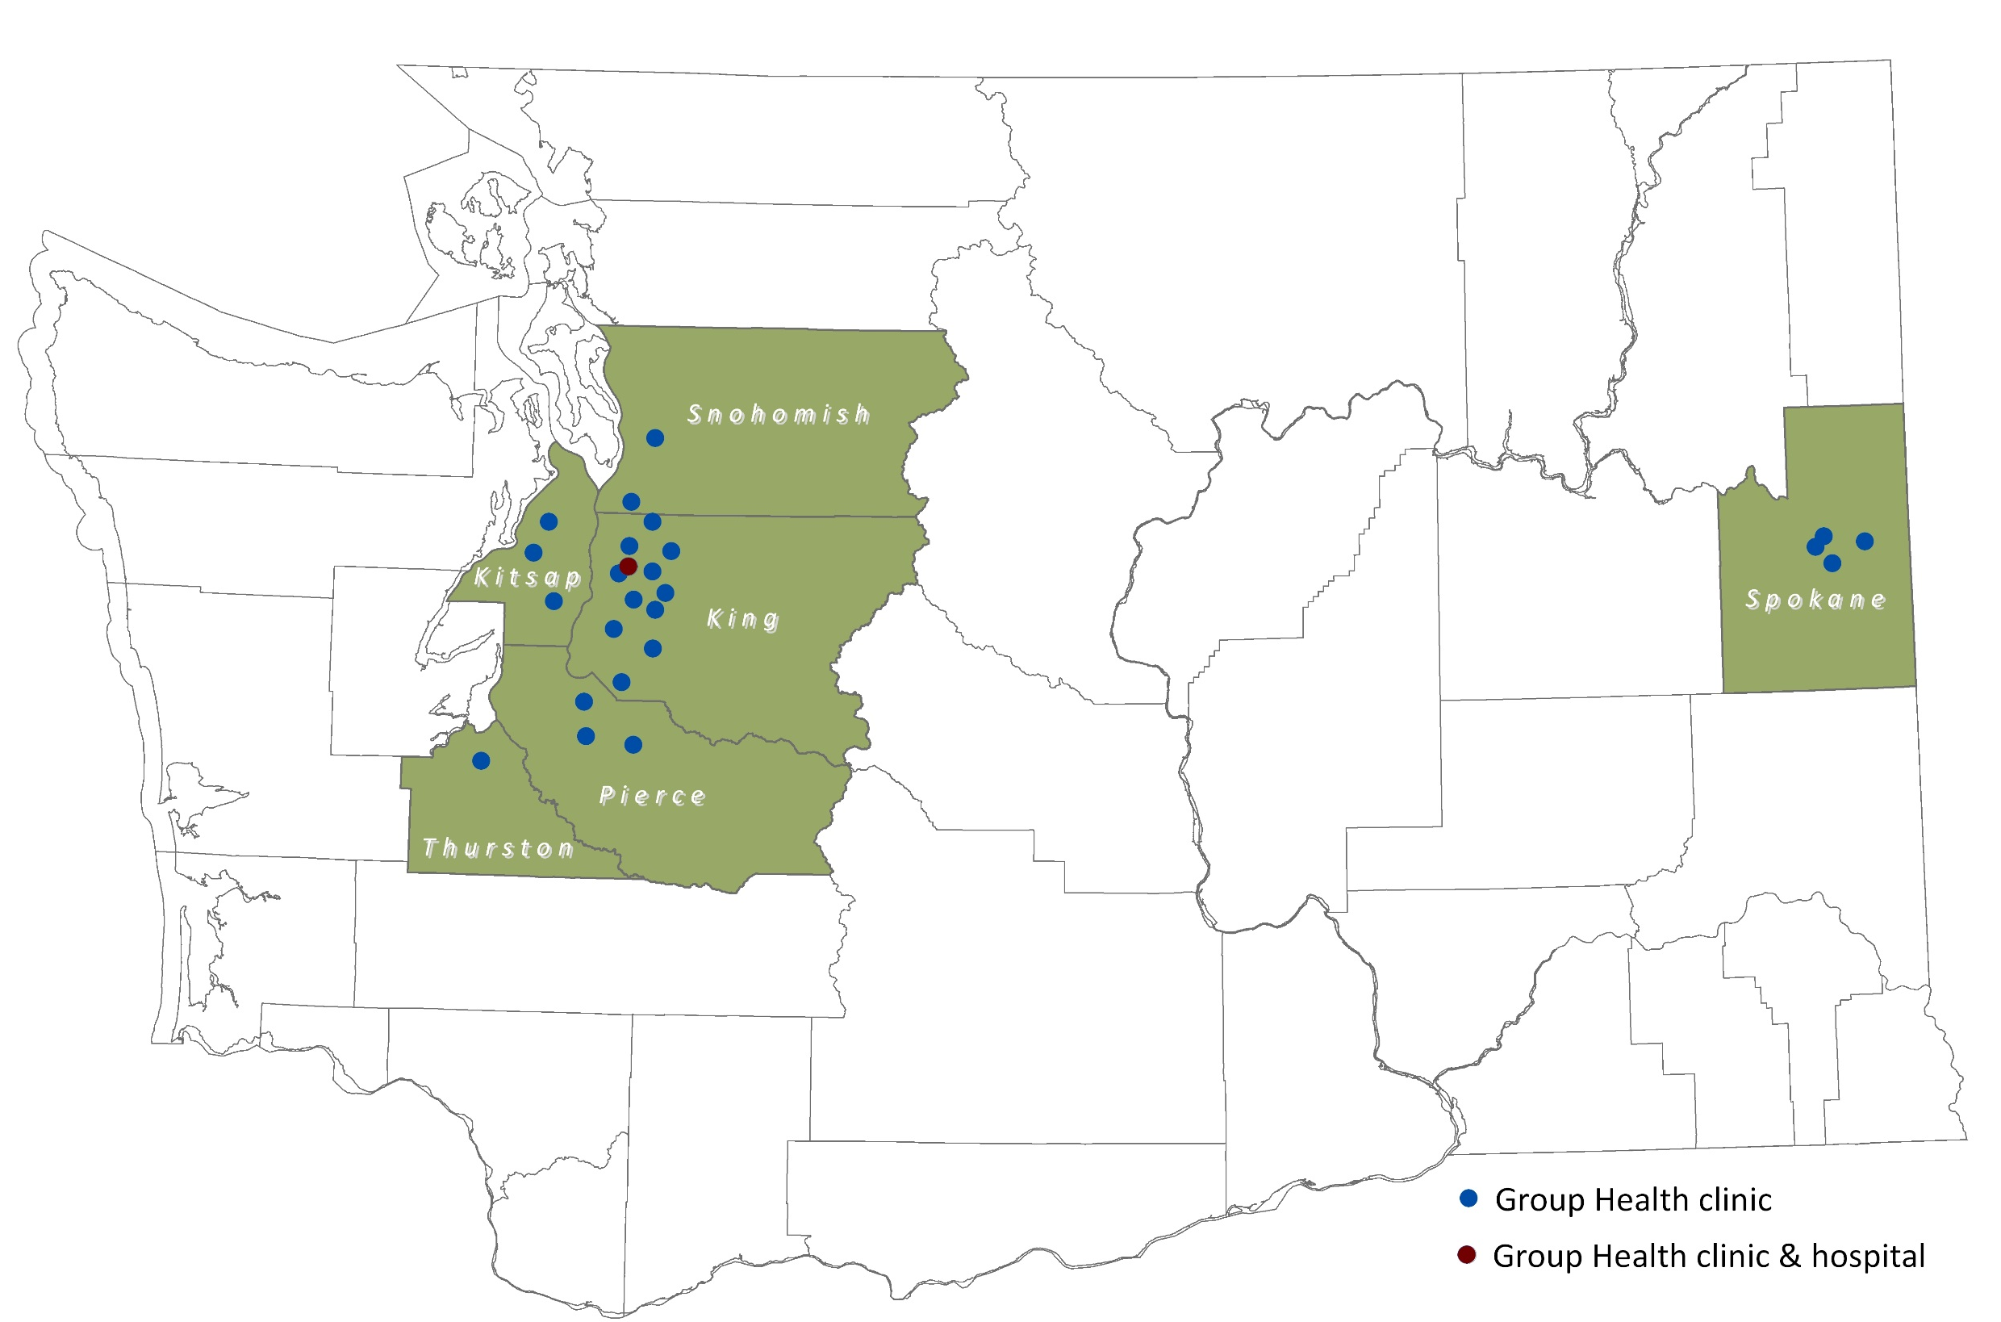
SPARC Trial: Setting

Slide 10
SPARC Trial: Setting
25 primary care sites spanning > 250 miles
  3 site pilot
  Stepped-wedge trial: 22 PC sites
IRB: waivers of consent & HIPAA
  Bobb IJERPH 2017; Glass Implementation Science 2018
Notes:
The trial took place in Kaiser Permanente Washington from January 2015 through July 2018. Implementation strategies included practice coaching, electronic health record (EHR) clinical decision support, and performance monitoring and feedback to local implementation teams. The sample included all patients seen for primary care across 25 sites during the study period . All measures relied on secondary data from EHR or insurance claims. The main outcome measure for prevention was documented brief intervention (BI) within 14 days of a positive AUDIT-C screen. Natural language processing and procedure codes were used to identify documented BI. The main outcome measure for AUD treatment was initiation and engagement in treatment, defined based on the US National Committee of Quality Assurance Healthcare Effectiveness Dataset Information System measures , requiring a visit with an AUD diagnosis within 14 days of initial diagnosis, with 2 more visits in the next 30 days . Analyses were conducted consistent with CONSORT for cluster-randomized trials (including intention to treat). We used general linear mixed models accounting for correlation of measures in the same person or site, adjusted for age, gender, race, ethnicity, ETC.
Edit if results are only 22 randomized clinisc
22?
Delete?
Delete this whole citation/source clause, not strictly necessary?
Or if required to keep source, (and I know this is sacrilegious) shorten to some combo such as:
US National Committee of Quality Assurance measures (skips HEDIS)
US Healthcare Effectiveness Dataset Information System (skip NCQA)
Should this be ‘for’? I’m not sure what is meant by ‘requiring a visit with an AUD diagnosis’
Or delete/shorten! 😊
“requiring a visit within 14 days of initial AUD diagnosis”
May not fit

Slide 11
SPARC Trial: Goal
Evidence-based primary care for unhealthy alcohol use
  Prevention: screening and brief alcohol counseling
  Diagnosis and treatment of alcohol use disorders (AUDs)
  USPSTF: Jonas Ann Intern Med 2012; Moyer Ann Intern Med 2013;
  (USPSTF 2018: O’Connor Ann Intern Med 2018)
  Anton JAMA 2006; Ernst Ann Fam Med 2008
  Jonas JAMA 2014; Bradley, Kivlahan JAMA 2014
Notes:
Evidence-based care for unhealthy alcohol use in primary care includes screening and brief intervention and treatment for alcohol use disorders including medications, medication management, and linkage to counseling and specialty alcohol treatment

Slide 12
SPARC Implementation Intervention
SPARC intervention – 3 implementation strategies:
  Enhanced model of practice facilitation (“coaching”)
  EHR decision support
  Performance monitoring and feedback
  Bobb IJERPH 2017; Glass Implementation Science 2018
  Nagykaldi 2005; Baskerville 2012; Taylor 2013

Slide 13
SPARC Trial: 25 Primary Care Clinics
Pragmatic Stepped Wedge Trial
Duration: months |  | 12 | 4 | 4 | 4 | 4 | 4 | 4
Pilot – 3 clinics |  | Pilot
Wave 1 – 3 clinics |  |  | 1
Wave 2 – 3 clinics |  |  |  | 2
Wave 3 – 3 clinics |  |  |  |  | 3
Wave 4 – 3-4 clinics |  |  |  |  |  | 4
Wave 5 – 3-4 clinics |  |  |  |  |  |  | 5
Wave 6 – 3-4 clinics |  |  |  |  |  |  |  | 6
Wave 7 – 3-4 clinics |  |  |  |  |  |  |  |  | 7
Notes:
Here is a schematic of the trial, and you’ll see that each new wave of randomized clinics started implementation every 4 months.

Slide 14
SPARC Intervention: Refinements Based on Pilot

Slide 15
SPARC Leadership
Partnership
  Clinical leaders
  Researchers
  Bobb IJERPH 2017; Glass Implementation Science 2018
  https://www.youtube.com/watch?v=tbKbq2IytC4
Notes:
FE = research team

Slide 16
SPARC – Scope
Expansion of scope of clinical care
    Implement w/ “Behavioral Health Integration (BHI)”
    Adding depression, suicidality and other drug use
    Social workers → integrated BH clinicians
  Bobb IJERPH 2017; Glass Implementation Science 2018
  https://www.youtube.com/watch?v=tbKbq2IytC4

Slide 17
SPARC Leadership
Implementation organization
  Formative evaluation - weekly
  Bobb IJERPH 2017; Glass Implementation Science 2018
  https://www.youtube.com/watch?v=tbKbq2IytC4
Notes:
FE = research team

Slide 18
Where we started
We don’t have enough time or resources to do this.
Whose idea was this?
We are too overwhelmed. This is opening up Pandora’s box.
This is a science project that others committed to and now we are being forced to prioritize it.
18
Notes:
So when we started working with the clinical teams, many were upset because we were asking them to do more with fewer staff.
What we heard from clinic teams when we first started (which might be familiar to many of you trying to implement change) included:
We don’t have enough time or resources to do this
Whose idea was this?
We are too overwhelmed. This is opening up Pandora’s box.
This is a research project that others (leaders) committed to, and now we are being forced to prioritize it.

Slide 19
SPARC Leadership
Implementation organization
  Formative evaluation - weekly
  All team meetings weekly
  Decision-making largely by consensus
  Clinical leaders made final decisions
  Bobb IJERPH 2017; Glass Implementation Science 2018
  https://www.youtube.com/watch?v=tbKbq2IytC4
Notes:
FE = research team

Slide 20
SPARC – Practice Coaching
SPARC Practice Coaching
    Scheduled weekly
      6 months: 2 preparation; 4 after launch
      Work with local quality improvement team
      Plan Do Check Adjust meeting weekly
      Leaders join monthly
    2 hours training: all PC staff
  Bobb IJERPH 2017; Glass Implementation Science 2018
  https://www.youtube.com/watch?v=tbKbq2IytC4

Slide 21
Implementation: 4 Phases Each Site
Months
Variable | 1 | 2 | 3 | 4 | 5 | 6 | Variable
Phase 1 | Phase 2 |  | Phase 3 |  |  |  | Phase 4
Usual care | Preparation |  | Active Implementation |  |  |  | Sustainment
Randomly assigned launch date
EHR prompts on for adult PC patients

Slide 22
Implementation: 4 Phases Each Site
Months
Variable | 1 | 2 | 3 | 4 | 5 | 6 | Variable
Phase 1 | Phase 2 |  | Phase 3 |  |  |  | Phase 4
Usual care | Preparation |  | Active Implementation |  |  |  | Sustainment
Randomly assigned launch date
EHR prompts on for adult PC patients

Slide 23
Implementation: 4 Phases Each Site
Months
Variable | 1 | 2 | 3 | 4 | 5 | 6 | Variable
Phase 1 | Phase 2 |  | Phase 3 |  |  |  | Phase 4
Usual care | Preparation |  | Active Implementation |  |  |  | Sustainment
Randomly assigned launch date
EHR prompts on for adult PC patients

Slide 24
Implementation: 4 Phases Each Site
Months
Variable | 1 | 2 | 3 | 4 | 5 | 6 | Variable
Phase 1 | Phase 2 |  | Phase 3 |  |  |  | Phase 4
Usual care | Preparation |  | Active Implementation |  |  |  | Sustainment
Randomly assigned launch date
EHR prompts on for adult PC patients

Slide 25
Implementation: 4 Phases Each Site
Months
Variable | 1 | 2 | 3 | 4 | 5 | 6 | Variable
Phase 1 | Phase 2 |  | Phase 3 |  |  |  | Phase 4
Usual care | Preparation |  | Active Implementation |  |  |  | Sustainment
Randomly assigned launch date
EHR prompts on for adult PC patients

Slide 26
BHI Clinical Care
Screen
Assess
Prevention, Shared decision making & treatment
Monitor and Adapt
7-Item Paper Screen
PHQ-2
AUDIT-C
Cannabis
Drugs
Notes:
Stress MAs
Add to slide?

Slide 27
BHI Clinical Care
Screen
Assess
Prevention, Shared decision making & treatment
Monitor and Adapt
7-Item Paper Screen
PHQ-2
AUDIT-C
Cannabis
Drugs
4 Possible Assessments
PHQ-9
Suicide risk assessment
Alcohol Symptom Checklist (SC)
Substance use SC
Notes:
Say front desk

Slide 28
BHI Clinical Care
Screen
Assess
Prevention, Shared decision making & treatment
Monitor and Adapt
7-Item Paper Screen
PHQ-2
AUDIT-C
Cannabis
Drugs
Alcohol Related care:
Brief alcohol counseling
Diagnose
Warm Handoffs to social work
Medications
“Mind-phone”
Referral
4 Possible Assessments
PHQ-9
Suicide risk assessment
Alcohol Symptom Checklist (SC)
Substance use SC
Notes:
Demo scren
Dx assessment
Columbia
Preventive HO
Getting started

Slide 29
Monitor
Screen
Assess
Shared Decision Making
Notes:
Demo scren
Dx assessment
Columbia
Preventive HO
Getting started

Slide 30
SPARC Trial: Randomization
Constraints placed on randomization
Randomized 22 primary care sites
Stratified: Year 1 (9 sites) vs Years 2-3 (13 sites)
Years 2-3:
      6 sites randomized as pairs (10 clusters total)
      All sites equal probability of falling in each wave
  Glass et.al. Implementation Science 2018

Slide 31
SPARC Prevention: Methods
Sample for SPARC trial:
All patients seen in 22 primary care sites
Each with a randomly assigned wave (start date)
Data Collection and Measures
Secondary electronic EHR data
  Bobb IJERPH 2017; Glass Implementation Science 2018
Notes:
OLD
The trial took place in Kaiser Permanente Washington from January 2015 through July 2018. Implementation strategies included practice coaching, electronic health record (EHR) clinical decision support, and performance monitoring and feedback to local implementation teams. The sample included all patients seen for primary care across 25 sites during the study period . All measures relied on secondary data from EHR or insurance claims. The main outcome measure for prevention was documented brief intervention (BI) within 14 days of a positive AUDIT-C screen. Natural language processing and procedure codes were used to identify documented BI. The main outcome measure for AUD treatment was initiation and engagement in treatment, defined based on the US National Committee of Quality Assurance Healthcare Effectiveness Dataset Information System measures , requiring a visit with an AUD diagnosis within 14 days of initial diagnosis, with 2 more visits in the next 30 days . Analyses were conducted consistent with CONSORT for cluster-randomized trials (including intention to treat). We used general linear mixed models accounting for correlation of measures in the same person or site, adjusted for age, gender, race, ethnicity, ETC.
Edit if results are only 22 randomized clinisc
22?
Delete?
Delete this whole citation/source clause, not strictly necessary?
Or if required to keep source, (and I know this is sacrilegious) shorten to some combo such as:
US National Committee of Quality Assurance measures (skips HEDIS)
US Healthcare Effectiveness Dataset Information System (skip NCQA)
Should this be ‘for’? I’m not sure what is meant by ‘requiring a visit with an AUD diagnosis’
Or delete/shorten! 😊
“requiring a visit within 14 days of initial AUD diagnosis”
May not fit

Slide 32
SPARC Trial: Main Analyses
Analyses consistent with CONSORT
    Cluster-randomized stepped-wedge trials
    Intention to treat (start date randomly assigned)
  Bobb IJERPH 2017; Glass Implementation Science 2018
  Hemming KM Stat Med 2018; Hemming KM BMJ 2018

Slide 33
SPARC Trial: Main Outcomes
Two Main Outcomes:
  Planned a priori to assess in entire PC sample
  (i.e. NOT in patients who needed the care)
  To avoid identification bias
  Measures per 28 day period
  Bobb IJERPH 2017; Glass Implementation Science 2018
  J. Bobb et. al. Designing to avoid identification bias, NIH Collaboratory ltextbook
  https://rethinkingclinicaltrials.org/chapters/design/experimental-designs-randomization-schemes-top/designing-to-avoid-identification-bias/

Slide 34
Implementation: 4 Phases Each Site
Usual Care
Months
Variable | 1 | 2 | 3 | 4 | 5 | 6 | Variable
Phase 1 | Phase 2 |  | Phase 3 |  |  |  | Phase 4
Usual care | Preparation |  | Active Implementation |  |  |  | Sustainment
Randomly assigned launch date
EHR prompts on for adult PC patients

Slide 35
Implementation: 4 Phases Each Site
Intervention
Months
Variable | 1 | 2 | 3 | 4 | 5 | 6 | Variable
Phase 1 | Phase 2 |  | Phase 3 |  |  |  | Phase 4
Usual care | Preparation |  | Active Implementation |  |  |  | Sustainment
Randomly assigned launch date
EHR prompts on for adult PC patients

Slide 36
SPARC Trial: Analyses
General linear mixed models (GLMM)
    Random effects for patient and site
    Accounts for correlation (same person & site)
    Adjusted for
    Time: calendar month
    Stratification variable: Year 1 vs 2-3
  Bobb IJERPH 2017; Glass Implementation Science 2018
Notes:
Hemming, K., K. Carroll, J. Thompson, A. Forbes, M. Taljaard and S.-C. r. group (2018). "Quality of stepped-wedge trial reporting can be reliably assessed using an updated CONSORT: crowd-sourcing systematic review." J Clin Epidemiol.
Hemming, K., M. Taljaard and A. Forbes (2018). "Modeling clustering and treatment effect heterogeneity in parallel and stepped-wedge cluster randomized trials." Stat Med 37(6): 883-898.
Hemming, K., M. Taljaard, J. E. McKenzie, R. Hooper, A. Copas, J. A. Thompson, M. Dixon-Woods, A. Aldcroft, A. Doussau, M. Grayling, C. Kristunas, C. E. Goldstein, M. K. Campbell, A. Girling, S. Eldridge, M. J. Campbell, R. J. Lilford, C. Weijer, A. B. Forbes and J. M. Grimshaw (2018). "Reporting of stepped wedge cluster randomised trials: extension of the CONSORT 2010 statement with explanation and elaboration." BMJ 363: k1614.
Hughes, J. P., T. S. Granston and P. J. Heagerty (2015). "Current issues in the design and analysis of stepped wedge trials." Contemp Clin Trials 45(Pt A): 55-60.
Hussey, M. A. and J. P. Hughes (2007). "Design and analysis of stepped wedge cluster randomized trials." Contemp Clin Trials 28(2): 182-191.
Hussey, M. A. and J. P. Hughes (2007). "Design and analysis of stepped wedge cluster randomized trials." Contemp Clin Trials 28(2): 182-191.
One thing to point out is that I noticed a few places where the results from our pre-specified generalized linear mixed effect model (GLMM) that includes a random intercept for both site and person was very different from the corresponding generalized linear model (GLM) that does not include the random intercepts. This occurred for a few outcomes (namely trt_outcome_main) where the model claims to have converged, but the inconsistently with the GLM results makes me very skeptical. I've tried running other optimization algorithms but many of them failed to converge. As I've mentioned, the model is complicated to fit because it has 2 different random effects and the dataset is really large (~1.4 million records).

Slide 37
Aim 1
Implementation of
Evidence-based Alcohol-related
Preventive Care

Slide 38
SPARC Aim #1: Prevention
Specific Aim #1: To evaluate whether the SPARC intervention increased the proportion of primary care patients who:
Had a positive screen for unhealthy alcohol use and brief alcohol counseling documented in their EHR
Notes:
The SPARC trial had two main aims. The first was to increase the proportion of primary care patients who have unhealthy alcohol use identified and brief intervention offered. The second aim was to increase the proportion of primary care patients who have an alcohol use disorder recognized and are engaged in alcohol-related care , as defined by the National Committee for Quality Assurance (or NCQA), an organization that develops quality measures for health systems.

Slide 39
SPARC Prevention: Background
Implementation of screening and brief counseling
Many unsuccessful efforts
World Health Organization multi-national effort:
  “High” rate of screening: 20%
  “High” rate of brief counseling: 10%
    Williams Psychology Addictive Behaviors 2011
    Anderson Alcohol Alcohol 2004
Notes:
At the time we designed this trial in 2013 there had been many failed efforts to implement screening and brief alcohol counseling
A WHO multinational study had such low rates of implementation that they considered
“High” rate of screening: 20%
“High” rate of brief counseling: 10%

Slide 40
SPARC Prevention: Background
SPARC Prevention Intervention
Built on lessons from VA (2003-2011)
VA used 2 implementation strategies:
  EHR clinical decision support
  Performance monitoring and feedback
VA → high rates of sustained documented
  Alcohol screening
  Brief alcohol counseling
    Bradley Am J Manag Care 2006; Lapham Med Care 2012

Slide 41
SPARC Prevention: Background
Limitations of VA implementation
Screening quality: 61% missed
EHR prompts → focus on clicking boxes
VA increased documentation > counseling
Patient-reported counseling only increased15%
Our assessment: neglected front-line “adopters”
    Bradley JGIM 2011; Chavez JSAD 2016; Berger JGIM 2018
    Greenhalgh Milbank Q 2004; Williams & Bradley ASAM Textbook 2013
Notes:
But the VA’s implementation had important limitations….
Quality of screening was poor: 61% of patients who screened positive on a confidential survey had a negative screen in their EHR
Clinical reminders focused providers on clicking boxes
And some of our research suggests that it just documented counseling that was already occurring
Nevertheless, there was 15% increase in patient-report of alcohol-related advice during the 4 years after implementation of alcohol counseling
We concluded that a major flaw of the implementation was our neglect of what the Greenhalgh model refers to as front line adopters

Slide 42
SPARC Prevention: Background
Gaps in preparing front-line primary care team
Lack of comfort addressing alcohol
  Staff who administer screening
  PC providers
Fear of offending patients
Lack of understanding focus on prevention
→ SPARC trial added: practice coaching
    McCormack JGIM 2007
    Williams JGIM 2015; Williams JSAT 2016; Willams JGIM 2018
    Nagykaldi 2005; Baskerville 2012; Taylor 2013

Slide 43
SPARC Prevention
Three Implementation Strategies
  Practice coaching …
  EHR tools
  Performance monitoring and feedback
  Bobb IJERPH 2017; Glass Implementation Science 2018
  https://www.youtube.com/watch?v=tbKbq2IytC4
Notes:
As Kathy said we used 3 implementation strategies, Im going to tell you how we used them for prevention

Slide 44
SPARC Prevention: Strategy #1
Practice coaches
Worked with QI team
Focus on work flow for screening/assessment
Increasing comfort by overcoming stigma
Scripting for MAs and front desk staff
Scripting for providers
Training
  Bobb IJERPH 2017; Glass Implementation Science 2018
Notes:
Practice coaches ….

Slide 45
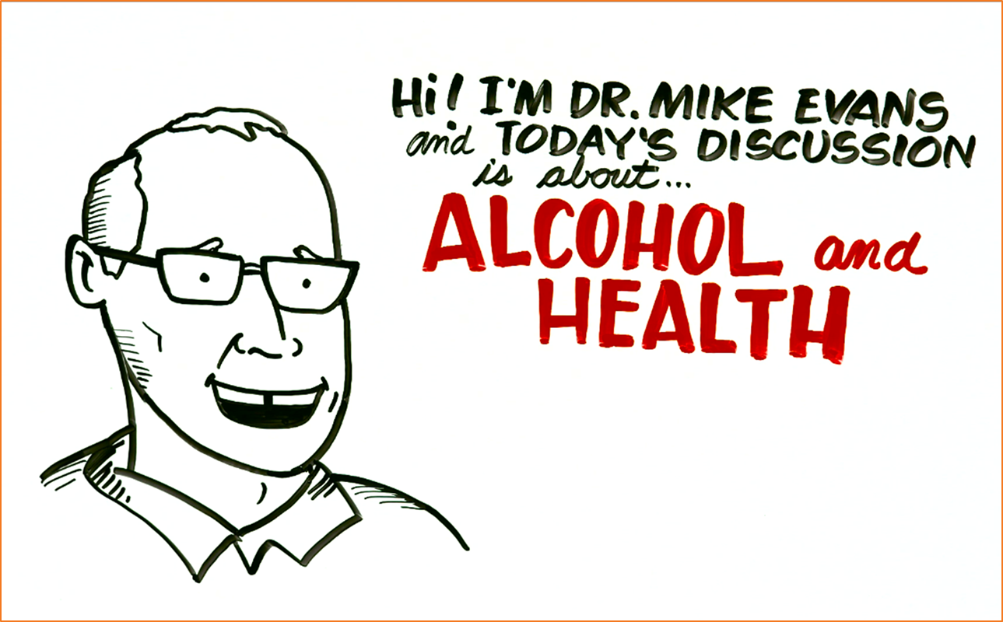
  https://www.youtube.com/watch?v=tbKbq2IytC4
Notes:
Our team developed a youtube video with Mike Evans that gave an overview of alcohol and health to increase knowledge and address stereotypes about unhealthy alcohol use both for patients and care teams. The video was used in our first team meeting as well as in trainings for primary care teams. The video was also embedded into after visit summaries for patients.

Slide 46
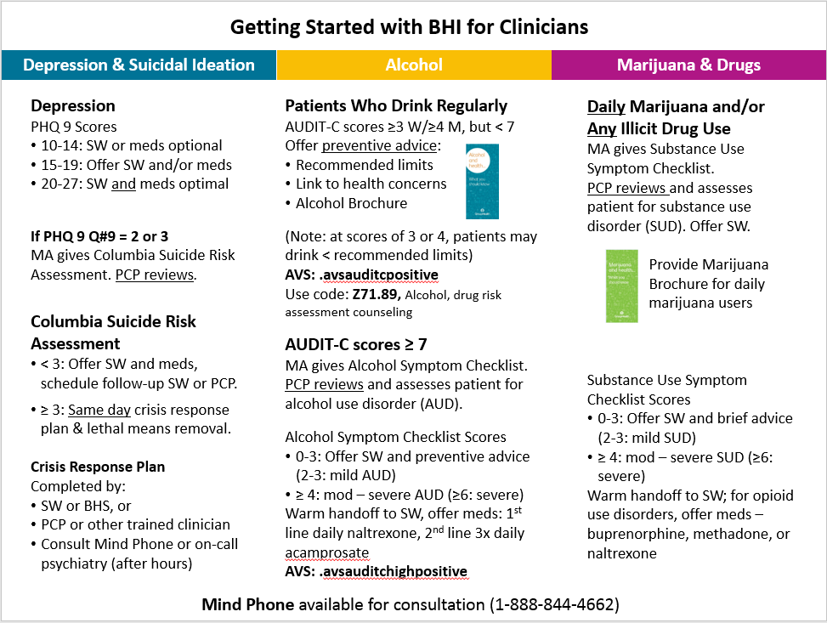
Notes:
Providers were trained to use the handout to counsel patients who drink regularly (because we learned that people were thinking of positive screens as bad????)
This was a an outline that coaches developed for primary care providers to help them understand the clinical work at a glance;
As you can see alcohol-related care is one of three sections in the document.

Slide 47
SPARC Prevention: Strategy #2
EHR prompts for MAs to:
Screening
Give PC providers Alcohol and Health handout
  Bobb IJERPH 2017; Glass Implementation Science 2018

Slide 48
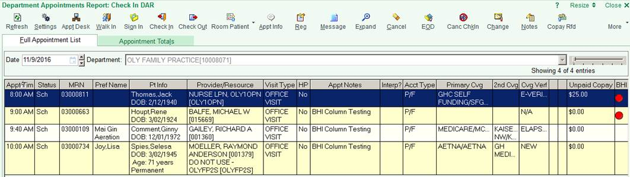
EHR Prompts: Annual Screening
For front desk check-in staff: red dots
Notes:
I’m going to show you some screenshots of our prompts just so you get a sense of what these look like. You likely won’t be able to read all the text. Here’s an example of how check-in staff and medical assistants were prompted to give patients a paper-based annual screen

Slide 49
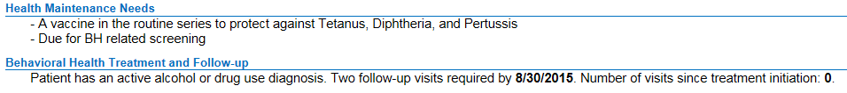
EHR Prompts: Annual Screening
For medical assistant & PCP dyads: Pre-visit prompt:

Slide 50
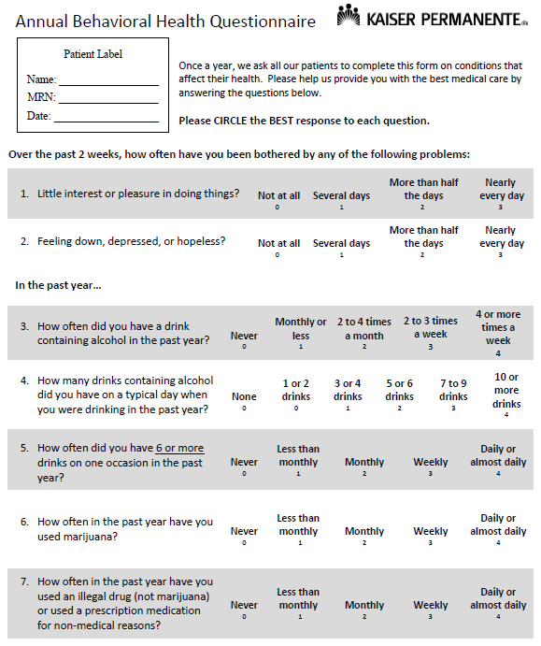
Annual Screening:
7-item
Screen

Slide 51
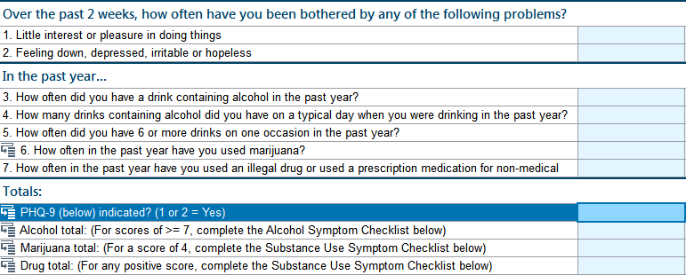
MA enters AUDIT-C into EHR
Notes:
Medical Assistants entered screening results, including the AUDIT-C, in the EHR during their rooming process.

Slide 52
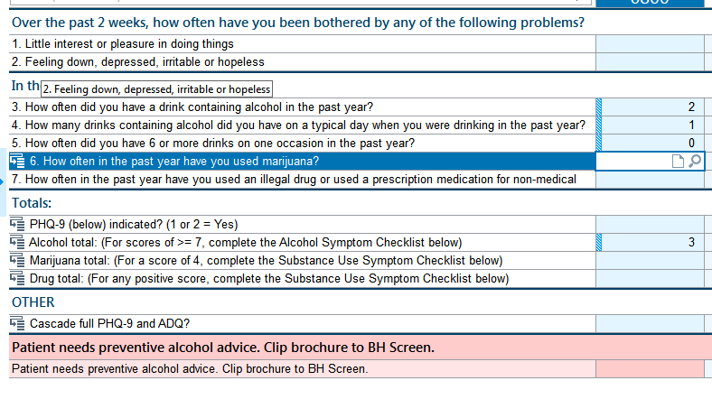
MA enters AUDIT-C into EHR
MA enters screen
Notes:
When AUDIT-C scores were 3 or more for women or 4 or more for men, there was an automated prompt for Medical Assistants to pull out an alcohol handout for providers to cue them that brief alcohol counseling was needed for the patient.

Slide 53
EHR Sums the AUDIT-C Score
AUDIT-C Score 3 appears
Notes:
When AUDIT-C scores were 3 or more for women or 4 or more for men, there was an automated prompt for Medical Assistants to pull out an alcohol handout for providers to cue them that brief alcohol counseling was needed for the patient.

Slide 54
Prompt for MA to give alcohol handout
MA is prompted to clip “Alcohol & Health” on PCP paperwork
Notes:
When AUDIT-C scores were 3 or more for women or 4 or more for men, there was an automated prompt for Medical Assistants to pull out an alcohol handout for providers to cue them that brief alcohol counseling was needed for the patient.

Slide 55
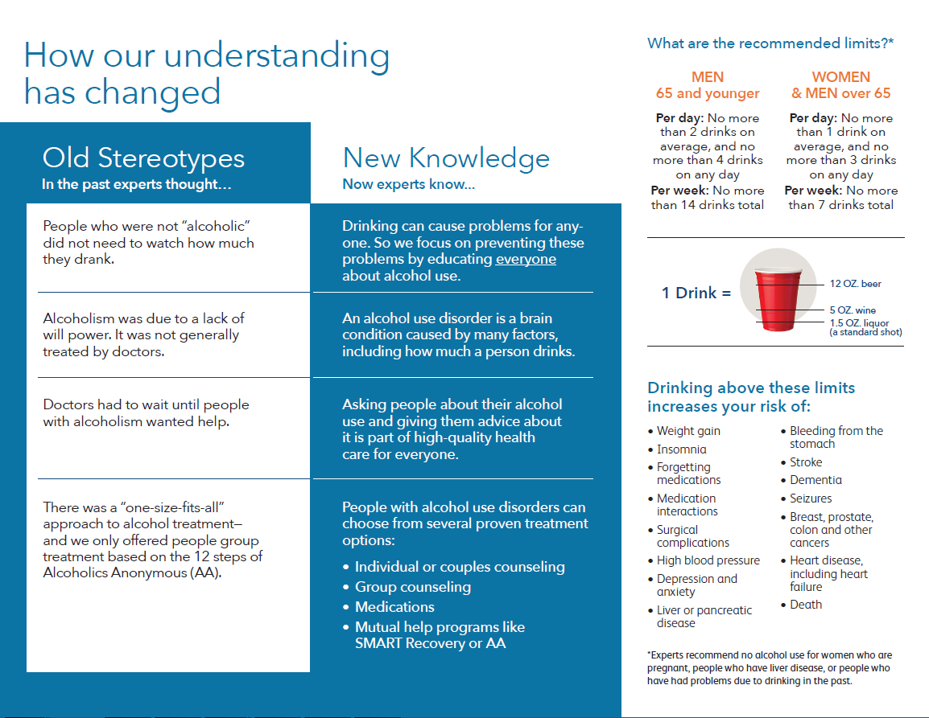
Stigma Reduction

Slide 56
For BI
Notes:
The handout also had information that is usually included in evidence-based brief counseling: recommended limits and health risks of drinking above limits.

Slide 57
SPARC Prevention: Strategy #3
Performance feedback
Screening
None for brief alcohol counseling
  Bobb IJERPH 2017; Glass Implementation Science 2018

Slide 58
Outcomes: Prevention

Slide 59
SPARC Prevention: Outcomes
Main Outcome Measure – Prevention:
  Positive AUDIT-C and
  Brief alcohol counseling or advice based on
      Natural language processing
      Billing codes
    At visit or within 14 days
  Bobb IJERPH 2017; Glass Implementation Science 2018
Notes:
Kathy reviewed the methods but the main outcome for prevention was …..
Having a positive AUDIT-C alcohol screen AND documented brief alcohol counseing
The trial took place in Kaiser Permanente Washington from January 2015 through July 2018. Implementation strategies included practice coaching, electronic health record (EHR) clinical decision support, and performance monitoring and feedback to local implementation teams. The sample included all patients seen for primary care across 25 sites during the study period . All measures relied on secondary data from EHR or insurance claims. The main outcome measure for prevention was documented brief intervention (BI) within 14 days of a positive AUDIT-C screen. Natural language processing and procedure codes were used to identify documented BI. The main outcome measure for AUD treatment was initiation and engagement in treatment, defined based on the US National Committee of Quality Assurance Healthcare Effectiveness Dataset Information System measures , requiring a visit with an AUD diagnosis within 14 days of initial diagnosis, with 2 more visits in the next 30 days . Analyses were conducted consistent with CONSORT for cluster-randomized trials (including intention to treat). We used general linear mixed models accounting for correlation of measures in the same person or site, adjusted for age, gender, race, ethnicity, ETC.
Edit if results are only 22 randomized clinisc
22?
Delete?
Delete this whole citation/source clause, not strictly necessary?
Or if required to keep source, (and I know this is sacrilegious) shorten to some combo such as:
US National Committee of Quality Assurance measures (skips HEDIS)
US Healthcare Effectiveness Dataset Information System (skip NCQA)
Should this be ‘for’? I’m not sure what is meant by ‘requiring a visit with an AUD diagnosis’
Or delete/shorten! 😊
“requiring a visit within 14 days of initial AUD diagnosis”
May not fit

Slide 60
SPARC Prevention: Outcomes
Secondary outcomes
Intermediate outcomes (e.g. screening)
Sensitivity analyses to assess assumptions about
    Time frame 60 days (a priori)
    Definitions, e.g. omit NLP and restricted to PC
Prevention cascade, describing day of visit:
Notes:
Secondary outcomes included
intermediate outcomes such as screening….
As well as variations in the definition of the main outcome, to see if our assumptions impacted outcomes.
Specifically we tested whether using a time window of 60 days like NCQA for brief counseling or omitting NLP changed our findings
In case helpful…. FROM FINAL REPORT TO AHRQ
An a priori secondary measure of preventive brief alcohol counseling measure used a 60-day time frame for counseling consistent with a recent HEDIS measure.²⁹ Two other post-hoc explanatory measures of brief alcohol counseling: 1) omitted counseling identified by NLP and used measures consistent with the recent HEDIS measure,³⁰ and 2) restricted the main composite measure to alcohol counseling in PC, to determine whether main findings were sensitive to the definition used for the main outcome.

Slide 61
SPARC Trial: Aim #1 Results
(Prevention)

Slide 62
SPARC Trial: Sample
 | Usual Care | Intervention
Number of patients | 255,801 | 228,270
Visit/patient, mean (sd) | 3.7 (3.8) | 2.7 (2.6)
Age, years, mean (sd) | 49 (18) | 50 (18)
Female (%) | 58.5 | 59.3
Notes:
In terms of results, this was a large sample of over 250,000 who were seen in the usual care period, and over 225,000 seen in the intervention period , with an average of 3 visits per patient per period

Slide 63
SPARC Trial: Sample
 | Usual Care | Intervention
Number of patients | 255,801 | 228,270
Visit/patient, mean (sd) | 3.7 (3.8) | 2.7 (2.6)
Age, years, mean (sd) | 49 (18) | 50 (18)
Female (%) | 58.5 | 59.3
Notes:
The average age was around 50

Slide 64
SPARC Trial: Sample
 | Usual Care | Intervention
Number of patients | 255,801 | 228,270
Visit/patient, mean (sd) | 3.7 (3.8) | 2.7 (2.6)
Age, years, mean (sd) | 49 (18) | 50 (18)
Female (%) | 58.5 | 59.3
Notes:
And most were female, close to 60%

Slide 65
SPARC Trial: Sample
 | Usual Care | Intervention
Hispanic | 5.9 | 5.9
Race (%)
Asian | 9.7 | 10.9
Black/AA | 5.7 | 5.5
Hawaiian/Pacific I. | 1.1 | 1.0
Native American | 0.8 | 0.7
Multiple | 3.1 | 3.0
Other | 3.6 | 3.8
Unknown | 3.8 | 4.7
White | 72.2 | 70.4
Notes:
Move to next slide!

Slide 66
SPARC Trial: Sample
 | Usual Care | Intervention
Hispanic | 5.9 | 5.9
Race (%)
Asian | 9.7 | 10.9
Black/AA | 5.7 | 5.5
Hawaiian/Pacific I. | 1.1 | 1.0
Native American | 0.8 | 0.7
Multiple | 3.1 | 3.0
Other | 3.6 | 3.8
Unknown | 3.8 | 4.7
White | 72.2 | 70.4
Notes:
The population is predominantly caucasion or white, the next largest group was Asian, and then a lesser prevalence of Hispanic and African American populations

Slide 67
SPARC Trial: Sample
 | Usual Care | Intervention
Insurance (%)
Commercial | 61.0 | 56.4
Medicaid | 3.6 | 3.1
Medicare | 22.7 | 23.9
Other | 3.0 | 3.1
Private Pay | 9.4 | 13.5
Tobacco Past Yr (%) | 9.4 | 9.5
Notes:
Move to next slide

Slide 68
SPARC Trial: Sample
 | Usual Care | Intervention
Insurance (%)
Commercial | 61.0 | 56.4
Medicaid | 3.6 | 3.1
Medicare | 22.7 | 23.9
Other | 3.0 | 3.1
Private Pay | 9.4 | 13.5
Tobacco Past Yr (%) | 9.4 | 9.5
Notes:
Insurance was predominantly commercially insured

Slide 69
SPARC Trial: Sample
 | Usual Care | Intervention
Insurance (%)
Commercial | 61.0 | 56.4
Medicaid | 3.6 | 3.1
Medicare | 22.7 | 23.9
Other | 3.0 | 3.1
Private Pay | 9.4 | 13.5
Tobacco Past Yr (%) | 9.4 | 9.5
Notes:
Then over a 5th of patients had medicare

Slide 70
SPARC Trial: Sample
 | Usual Care | Intervention
Insurance (%)
Commercial | 61.0 | 56.4
Medicaid | 3.6 | 3.1
Medicare | 22.7 | 23.9
Other | 3.0 | 3.1
Private Pay | 9.4 | 13.5
Tobacco Past Yr (%) | 9.4 | 9.5
Notes:
And about 9% used tobacco in the past year

Slide 71
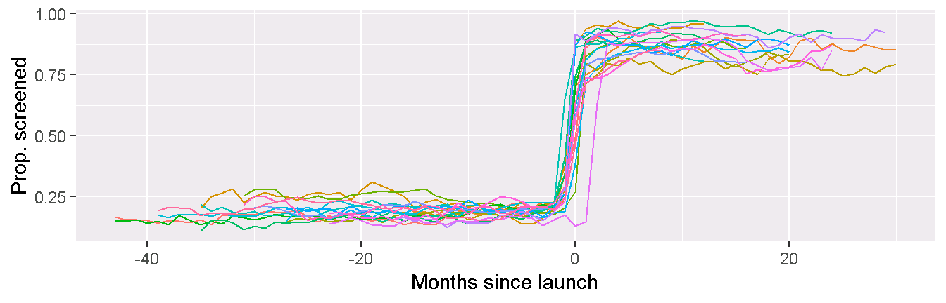
Interrupted Time Series: Screening
Alcohol screening rates: 22 primary care sites
Notes:
This graph of shows how alcohol screening rates with the AUDIT-C increased dramatically and were sustained across our 22 primary care sites.
The 0 near the middle of the graph represents the randomized launch dates for each of the sites.
As you can see, the proportion of alcohol screening before launch was low across all sites; below 30%,
and after the launch, rates of screening were above 75% in all sites, sustaining even after the active 6 months of practice coaching ended in the teams.

Slide 72
SPARC Trial: Prevention
Prevention Intermediate Outcomes Usual Care vs Intervention per 10,000 PC patients
 | UC | Intervention | p
Screened | 2081 | 8319 | < 0.0001
Most recent screen positive | 502 | 1802 | < 0.0001
High Positive | 54 | 148 | < 0.0001
Notes:
This slide of secondary outcomes shows that the % screened, the % positive and the % with high positive screens all increased significantly after the launch date.

Slide 73
Main Outcome: Prevention
Prevention: Aim #1 Main Outcome (Bold) Usual Care vs Intervention per 10,000 PC patients
 | UC | Intervention | p
Screened | 2081 | 8319 | < 0.0001
Most recent screen positive | 502 | 1802 | < 0.0001
High Positive | 54 | 148 | < 0.0001
Brief alcohol counseling | 11 | 57 | < 0.0001
Notes:
And our main prevention outcome—brief alcohol counseling– increased significantly as well, with a 5 fold increase.
Results were not meaningfully changed in sensitivity analyses with varying definitions.

Slide 74
Results: Prevention Cascade
Notes:
This graph shows the number of people who were seen in primary care during usual care and SPARC intervention periods
During usual care period, looking at the dark blue bar, very few patients were screened, about 12,000….
But on the Right you can see, that during the SPARC period almost 180,000 patients were screened (79%),
with over 50,000 (29%) screening positive, and about 2400 having brief counseling documented
Unfortunately that is only 5% of the positive screens

Slide 75
Qualitative Observations
Coaches focused on screening & assessment
Front-line design was key
Each site had marked resistance at start
  Stories → tipping points
  Scope of Behavioral Health Integration was key
Spectrum of comfort/quality
  Some gave handout instead of counseling
  Others were very thorough
Notes:
Id like to summarize some of our main observations conducting the trial….

Slide 76
Limitations
Focus on alcohol limited due to expanded scope
  Minimal training in brief alcohol counseling
  No PC provider EHR prompt for counseling
  No performance feedback for counseling
Main measure of counseling - documentation
  Effectiveness unknown
Generalizability?
  Intensive 6 months of coaching
  Single integrated health system with single EHR
  System supported integrated BH clinicians

Slide 77
Summary
Implementation strategies improved prevention
5-fold increase in brief alcohol counseling
High rate of screening
Room for improvement:
  Counseling rate low: 5% of positive screens
  Quality of counseling unknown
Notes:
At the same time, there is room for improvement…

Slide 78
Implications
Important achievements
High rate of screening
High prevalence positives: 29% on day of visit
Additional efforts needed
To increase brief alcohol counseling
Maximize PC clinicians comfort/expertise
Notes:
At the same time, there is room for improvement…

Slide 79
Thank You!

Slide 80
Questions? Comments?

Slide 81
Aim 2
Improving Care for
AUD in PC

Slide 82
SPARC Aim #2
Specific Aim
To evaluate whether the SPARC intervention increased the proportion of PC patients who:
Had new alcohol use disorder (AUD) diagnosed with subsequent initiation and engagement in alcohol treatment
Notes:
The SPARC trial had two main aims. The first was to increase the proportion of primary care patients who have unhealthy alcohol use identified and brief intervention offered. The second aim was to increase the proportion of primary care patients who have an alcohol use disorder recognized and are engaged in alcohol-related care , as defined by the National Committee for Quality Assurance (or NCQA), an organization that develops quality measures for health systems.

Slide 83
Background AUD Treatment
Treatment for AUD in primary care:
Medication and medication management
Counseling
Specialty addiction treatment programs
Mutual/Peer support (AA, SMART recovery etc.)
PC supported self-change
  Anton JAMA 2006; Ernst Ann Fam Med 2008
  Oslin JGIM 2014
  Jonas JAMA 2014; Bradley, Kivlahan JAMA 2014
  VA/DOD substance use disorders guideline
Notes:
Evidence-based care for unhealthy alcohol use in primary care includes screening and brief intervention and treatment for alcohol use disorders including medications, medication management, and linkage to counseling and specialty alcohol treatment

Slide 84
Background AUD Treatment
Previous PC efforts to address AUD focused on
Secondary screens: AUDIT or 2-item screen
Referral or linkage to treatment
  Not proven efficacious
  Brief counseling associated with decrease?
  Even in trials of dedicated SUD resources (care management): findings inconsistent
  Mertens ASCP 2015; Glass Addiction 2015, 2016; Frost Addiction 2019
  Saitz JAMA 2013; Oslin JGIM 2014; Watkins JAMA –IM 2017; Bradley JAMA-IM 2018
Notes:
Evidence-based care for unhealthy alcohol use in primary care includes screening and brief intervention and treatment for alcohol use disorders including medications, medication management, and linkage to counseling and specialty alcohol treatment

Slide 85
SPARC Alcohol-related Clinical Care
SPARC approach to PC management of AUDs
Identify patients w/ high risk drinking: AUDIT-C ≥ 7
DSM-5 alcohol symptom checklist (0-11)
PC clinicians make AUD diagnosis
Shared decision-making re: options
Support initiation & engagement in treatment
  Bobb IJERPH 2017; Glass Implementation Science 2018
  https://www.youtube.com/watch?v=tbKbq2IytC4

Slide 86
AUDIT-C and AUD Risk
Mean
drinks
per day
0 3 4 7 10 12
AUDIT-C Scores
Rubinsky (Secondary analyses of NESARC) ACER 2013
Notes:
86
(or …we defined 7-12 as high risk needing assessment based on this study … or just Why did we pick 7?)
Our research in a national probability sample suggested that is the score where consumption starts to increase exponentially

Slide 87
AUDIT-C and AUD Risk
80%
40%
AUDIT-C
Rubinsky (Secondary analyses of NESARC) ACER 2013
Notes:
87
And in the same paper: 40% of patient met criteria for DSM-iV (RIGHT?) AUD while 80% met criteria at AUDIT-C of 12

Slide 88
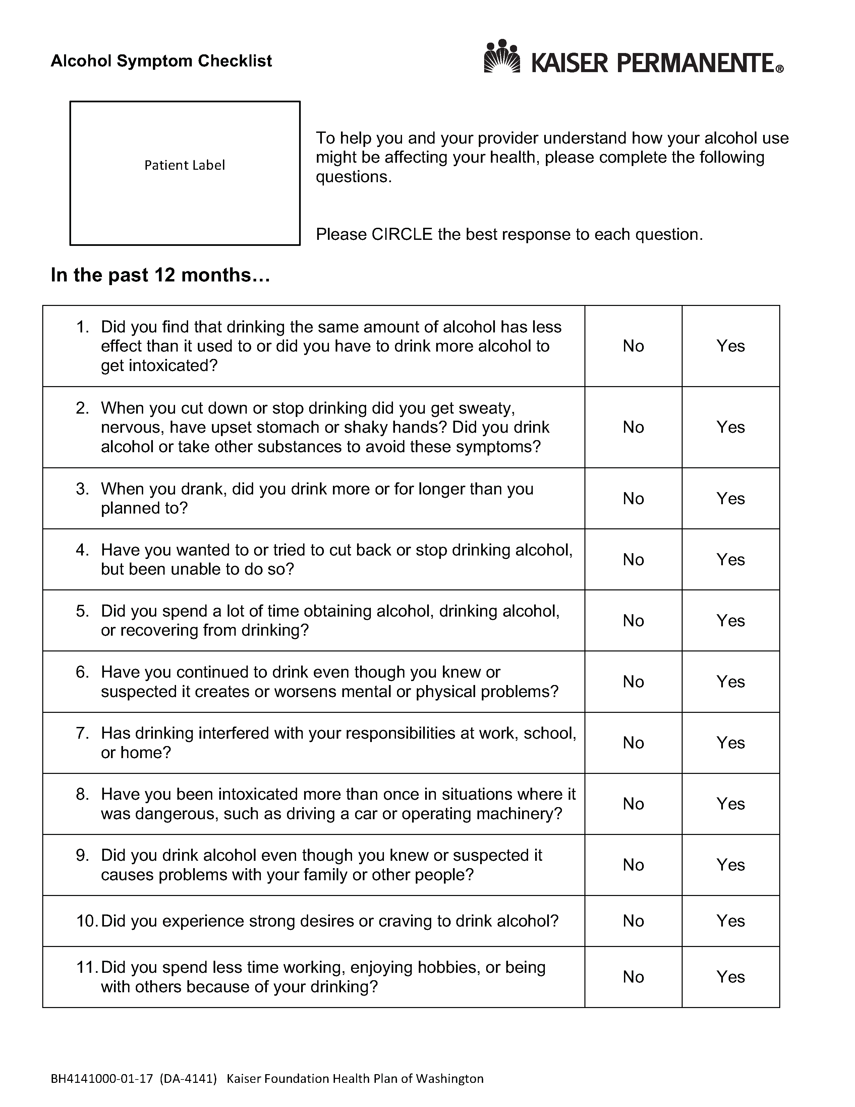
Alcohol
Symptom
Checklist
Notes:
The provider might say: you indicated you had tried to cut down and been unable. Can you tell me about that?

Slide 89
SPARC Alcohol-related Clinical Care
Management of AUDs within primary care
Identify patients w/ high risk drinking: AUDIT-C ≥ 7
DSM-5 alcohol symptom checklist (0-11)
PC clinicians make AUD diagnosis
Shared decision-making re: options
Support initiation & engagement in treatment
  Bobb IJERPH 2017; Glass Implementation Science 2018
  https://www.youtube.com/watch?v=tbKbq2IytC4

Slide 90
SPARC: Implementation Strategy #1
Practice coaches:
Increasing comfort by overcoming stigma
Scripting for MAs
Training:
  All staff – 1 hour
  PCP/RN training and MA/front desk training
  Same: video, handout, “Getting Started Guide”
  DSM-5 checklist → conversation starter
  Shared decision-making
  Bobb IJERPH 2017; Glass Implementation Science 2018
Notes:
Is red needed ?
I think so

Slide 92
Notes:
This is an example of a job aid practices coaches developed for primary care providers to help them understand the clinical work at a glance; and you’ll notice that alcohol-related care is one of three sections in the document.

Slide 93
SPARC: Implementation Strategy #2
EHR prompts
MAs: AUDIT-C 7-12 → DSM-5 checklist
PCPs: Best Practice Alert
  Bobb IJERPH 2017; Glass Implementation Science 2018
Notes:
For SPARC

Slide 94
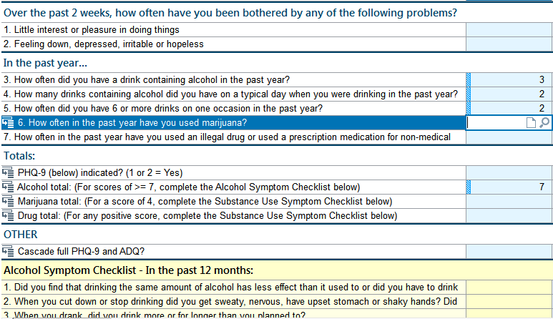
Prompt for MA to give Alcohol Symptom Checklist
AUDIT-C score 7
Notes:
And if patients scored a 7 or more on the AUDIT-C, there was an automated prompt for Medical Assistants to give patient an 11-item Alcohol Use Disorder symptom checklist

Slide 95
Prompt for MA to give Alcohol Symptom Checklist
AUDIT-C score 7
MA prompted by DSM-5 Alcohol Symptom Checklist opens up
Notes:
And if patients scored a 7 or more on the AUDIT-C, there was an automated prompt for Medical Assistants to give patient an 11-item Alcohol Use Disorder symptom checklist

Slide 96
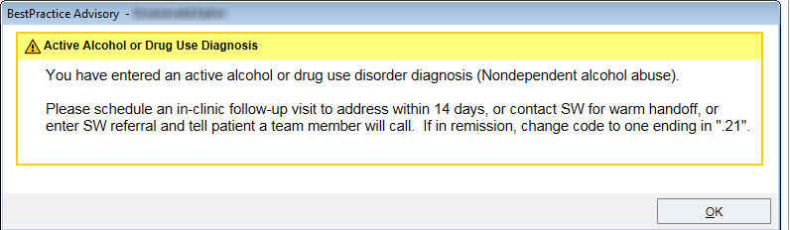
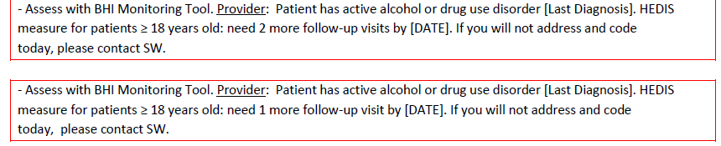
Prompts for AUD Treatment
Best Practice Alert (BPA)
Pre-visit summary prompts:
Notes:
We also had EHR prompts for alcohol and drug use disorder treatment. This included a best practice alert for treatment initiation at the time of new diagnosis, and pre-visit summary prompts for treatment engagement.

Slide 97
SPARC: Implementation Strategy #3
Coaches provided performance feedback:
% checklists completed when “due” weekly
NCQA HEDIS measure of initiation of alcohol or drug (AOD) treatment (monthly)
  Bobb IJERPH 2017; Glass Implementation Science 2018
Notes:
For SPARC

Slide 98
Performance Feedback – Alcohol
No leadership support for feedback measures of:
Evidence-based treatment
  Behavioral treatment
  Medication
  Specialty treatment
AUD Treatment engagement
Notes:
The purpose of this presentation is to describe the enhanced practice coaching model we used in our 22 randomized primary care clinics, as well as to present two performance metrics we fed back to our clinic teams, including alcohol screening with the AUDIT-C and AUD assessment with an 11-item alcohol symptom checklist in those same randomized clinics over two phases – post-implementation and sustainment

Slide 99
SPARC Trial: Aim 2 Methods
Methods same as for Aim 1 …
except outcome
  Bobb IJERPH 2017; Glass Implementation Science 2018
Notes:
New AUD defined as no AUD in past year
Initiation is a follow-up visit within 14 days with a diagnosis meeting criteria for alcohol or drug trreatment initiation per NCQA HEDIS measures
Engagement required 2 more visits in the next 30 days
We required all 3: new diagnosis, initiation and engagement for our main outcome measure for AUD treatment
As above it was evaluated in the entire PC sample with
General linear mixed models (GLMM)
Random effects for patient and site
Accounts for correlation (same person & site)
Adjusted for
Time: calendar month
Stratification variable: Year 1 vs 2-3
US National Committee for Quality Assurance Healthcare Effectiveness Dataset Information System measure ICD codes

Slide 100
SPARC Trial: Aim 2 Methods
2. Alcohol Treatment Main Outcome
  New (in past 365 days) AUD diagnosis at visit
  and
  Evidence of AUD treatment
    Based on ICD codes (NCQA HEDIS AOD)
    Initiation: 1st visit within 14 days
    Engagement: 2 more within next 30 days
  Bobb IJERPH 2017; Glass Implementation Science 2018
Notes:
New AUD defined as no AUD in past year
Initiation is a follow-up visit within 14 days with a diagnosis meeting criteria for alcohol or drug trreatment initiation per NCQA HEDIS measures
Engagement required 2 more visits in the next 30 days
We required all 3: new diagnosis, initiation and engagement for our main outcome measure for AUD treatment
As above it was evaluated in the entire PC sample with
General linear mixed models (GLMM)
Random effects for patient and site
Accounts for correlation (same person & site)
Adjusted for
Time: calendar month
Stratification variable: Year 1 vs 2-3
US National Committee for Quality Assurance Healthcare Effectiveness Dataset Information System measure ICD codes

Slide 101
Results Aim 2

Slide 102
SPARC Trial: Treatment
Alcohol Treatment: Aim #2 Intermediate Outcomes Usual Care vs Intervention per 10,000 PC patients
 | UC | Intervention | p
High Positive | 54 | 148 | < 0.0001
DSM-5 Assessment for AUD | 4.1 | 81 | < 0.0001
New AUD diagnosis at visit | 29 | 34 | 0.003
New AUD dx and initiated Tx | 6.2 | 7.8 | 0.042
Notes:
High positive & DSM-5 alcohol checklist at visit or past year
4.1
81
< 0.0001

Slide 103
Main Outcome: Treatment
Alcohol Treatment: Aim #2 Main Outcome (Bold) Usual Care vs Intervention per 10,000 PC patients
 | UC | Intervention | p
High Positive | 54 | 148 | < 0.0001
DSM-5 Assessment for AUD | 4.1 | 81 | < 0.0001
New AUD diagnosis at visit | 29 | 34 | 0.003
New AUD dx and initiated Tx | 6.2 | 7.8 | 0.042
AUD treatment engagement | 1.8 | 1.4 | 0.30

Slide 104
Results: AUD Diagnosis

Slide 105
Qualitative Observations
Clinicians liked
  DSM-5 AUD checklist
  Symptoms entered into EHR before visit
Little focus on HEDIS AOD performance measures
Integrated behavioral health clinicians: key role
Occasional patient w/ AUD → story & tipping point
Notes:
Visits coded for alcohol or drug use disorders do not indicate treatment (it could indicate that diagnosis complicated treatment or was taken into consideration or discussed)
This implementation study could not evaluate patient outcomes
Same limitations as for Aim 1 regarding generalizability

Slide 106
Limitations
Visits coded for AOD do not indicate treatment
SPARC could not evaluate patient outcomes
Generalizability
  Same as Aim 1
  Integrated BH clinicians played a role
Notes:
Visits coded for alcohol or drug use disorders do not indicate treatment (it could indicate that diagnosis complicated treatment or was taken into consideration or discussed)
This implementation study could not evaluate patient outcomes
Same limitations as for Aim 1 regarding generalizability

Slide 107
Summary
SPARC approach using DSM-5 checklist …
  Feasible and liked by clinicians
  Allowed patient-centered care inquiry re symptoms
  Increased new diagnosis and treatment initiation
Further efforts needed to increase treatment engagement
  Qualitative data from patients and providers
  Shared decision-making with patient decision aid?
  Bobb IJERPH 2017; Glass Implementation Science 2018
Notes:
US National Committee of Quality Assurance Healthcare Effectiveness Dataset Information System measures
, requiring a visit with an AUD diagnosis within 14 days of initial diagnosis, with 2 more visits in the next 30 days . 22?
Delete?
Delete this whole citation/source clause, not strictly necessary?
Or if required to keep source, (and I know this is sacrilegious) shorten to some combo such as:
US National Committee of Quality Assurance measures (skips HEDIS)
US Healthcare Effectiveness Dataset Information System (skip NCQA)
Should this be ‘for’? I’m not sure what is meant by ‘requiring a visit with an AUD diagnosis’
Or delete/shorten! 😊
“requiring a visit within 14 days of initial AUD diagnosis”
May not fit

Slide 108
Where we ended
I wouldn’t go back to providing care the way I used to if they asked me to.
The best roll-out of any program I’ve experienced.
I felt empowered to help this patient when she was in need.
One of the best things that has happened to my primary care practice…this is just how we do primary care now.
Notes:
Nearing the end of our trial, the response from our clinic teams had changed. Now we hear providers, clinic support staff, and leaders telling us:

Slide 109
Next Steps
125 small to medium primary care clinics in Michigan
Partnered with Altarum (Anya Day MPI)
Stepped wedge:
  SPARC aligned with CMS P4P
  + CME and MOC
Test a patient decision aid in 50% of sites
AHRQ – R18 HS027076 Michigan SPARC (Bradley/Day)
  Bobb IJERPH 2017; Glass Implementation Science 2018
Notes:
US National Committee of Quality Assurance Healthcare Effectiveness Dataset Information System measures
, requiring a visit with an AUD diagnosis within 14 days of initial diagnosis, with 2 more visits in the next 30 days . 22?
Delete?
Delete this whole citation/source clause, not strictly necessary?
Or if required to keep source, (and I know this is sacrilegious) shorten to some combo such as:
US National Committee of Quality Assurance measures (skips HEDIS)
US Healthcare Effectiveness Dataset Information System (skip NCQA)
Should this be ‘for’? I’m not sure what is meant by ‘requiring a visit with an AUD diagnosis’
Or delete/shorten! 😊
“requiring a visit within 14 days of initial AUD diagnosis”
May not fit

Slide 110

Options Study:
Patient
Decision
Aid
NIAAA R21 AA023037

Slide 111
Thank You!

Slide 112

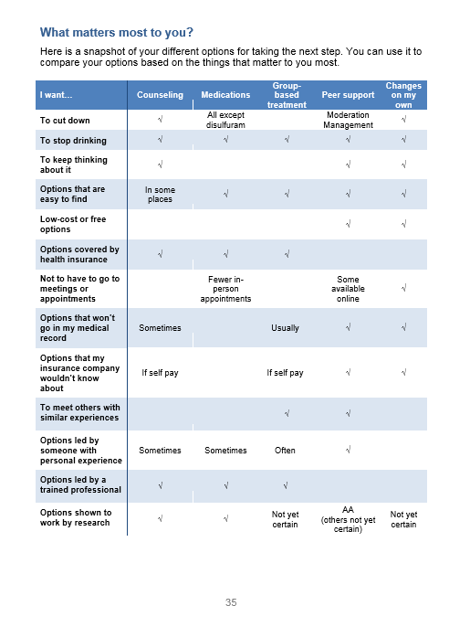
Stories
Destigmatize
& Engage
Option Grid:
5 Types of
Treatment
Worksheet
Share with PCP
NIAAA R21 AA023037

Slide 113
Questions? Comments?

Slide 114
Thank You!

Slide 115

Sustainment
@jangerhofer

Slide 116
Key Take-Away
SPARC implementation strategies helped sustain prevention-related activities for unhealthy alcohol use, but not treatment engagement for AUDs.
Notes:
The point we want you to take away from this presentation is that SPARC implementation strategies helped sustain prevention-related activities for unhealthy alcohol use, but not treatment engagement for AUDs.

Slide 117
Definition
Sustainability= continuation of a innovation within an organization/community
      Maintenance health benefits/outcome
      Institutionalization of program activities
      Capacity building (e.g. trainings, resources) SPA
      RC
      SPARC = “Sustained”
      = “Shediac-Rizkallah, Health Education Research, 1998
  Scheirer, American Journal of Eval, 2005
  Wiltsey Stirman, Implemenation Science, 2012
Notes:
Most of you all are likely well-acquainted sustainability, which is the continuation of an innovation within an organization or community. Commonly used definitions include constructs like maintenance of health benefits or outcomes of a program, institutionalization of program activities, and capacity-building activities like trainings and other resources that result in long-lasting support for the intervention..

Slide 118
Definition
Sustainability= continuation of a innovation within an organization/community
      Maintenance health benefits/outcome
      Institutionalization of program activities
      Capacity building (e.g. trainings, resources) SPA
      RC
      SPARC = “Sustained”
      = “Shediac-Rizkallah, Health Education Research, 1998
  Scheirer, American Journal of Eval, 2005
  Wiltsey Stirman, Implemenation Science, 2012
Notes:
And here I’ll remind you briefly that the “S” in SPARC stands “Sustained” so sustainment was really operationalized in this intervention from the beginning

Slide 119




Implementation Strategies
Practice facilitation (“coaching”)
EHR clinical decision support
Performance monitoring and feedback
  Bobb IJERPH 2017; Glass Implementation Science 2018
  https://www.youtube.com/watch?v=tbKbq2IytC4
Notes:
Kathy described the 3 main implementation strategies earlier, but just a reminder these were practice facilitation, EHR clinical decision support and performance monitoring and feedback.
Practices coaches met with local implementation teams routinely for 4 months to help them build SPARC the intervention into their existing clinical workflows. Likewise, clinical decision support tools were built into the electronic medical record system at KP Washington and continue to prompt alcohol related care over a year after the study period ended. Performance metrics were also built to measure screening for unhealth alcohol use and AUD assessment over time, NOT just during the intervention, but to remain in place for leaders to continue to monitor screening and assessment long after the implementation phase.

Slide 120
SPARC Phases
Months
Variable | 1 | 2 | 3 | 4 | 5 | 6 | Variable
Phase 1 | Phase 2 |  | Phase 3 |  |  |  | Phase 4
Usual Care | Preparation |  | Active Implementation |  |  |  | Sustainment
Randomly assigned launch date
Notes:
Kathy also covered this earlier, but I thought it might be helpful to remind you briefly that there were 4 phases of implementation for each clinic: usual care, preparation, and after the randomly assigned launch date, active implementation and sustainment.

Slide 121

During ACTIVE Implementation
EHR Tools
Coaches
Clinical Teams
Leaders
Operations & Research
Performance Metrics
  Bobb IJERPH 2017; Glass Implementation Science 2018
Notes:
During the ACTIVE implementation phase practice coaches were the main link to the clinical teams and shared their experiences and perspectives across the different teams involved in supporting behavioral health integration, INCLUDING with the electronic health record programmers and the performance metric development team. They also meet weekly with the leadership team which included researchers and clinical operations leaders, who also joined monthly quality improvement meetings with local clinic teams.

Slide 122
During SUSTAINMENT
EHR Tools
Clinical Teams
Leaders
Operations
Performance Metrics
Notes:
During the SUSTAINMENT phase operational leaders of behavioral health integration shifted into this linking role. These operations leaders continued to have quarterly quality improvement meetings with a local team at each clinic, using the same format as the coaches. They helped troubleshoot problems, including those with the clinical decision support tools in the EHR. They also continued to send monthly performance metric data to clinic leaders, which was also posted on the internal KP Washington website.

Slide 123
Sustainment Evaluation
Statistical analyses (pre-planned)
Descriptive (performance metrics)
Notes:
The sustainment evaluation include statistical analyses that were pre-planned as well as descriptive statistics using the most recent performance metric data available. I’m going to describe the pre-planned statistical analyses methods and results first and the descriptive performance metrics after that.

Slide 124
Statistical Analyses
Pre-planned, comparing 3 phases
  Main outcomes: 1) Brief alcohol counseling, 2) AUD treatment engagement
General linear mixed models (GLMM)
  Random effects for patient and site
    Accounts for correlation (same person & site)
    Adjusted for
    Time: calendar month
    Stratification variable: Year 1 vs 2-3
Bobb IJERPH 2017; Glass Implementation Science 2018
Notes:
The pre-planned statistical analyses compared 3 phases (next slide)

Slide 125
3 Phase Comparisons
Months
Variable | 1 | 2 | 3 | 4 | 5 | 6 | Variable
Phase 1 | Phase 2 |  | Phase 3 |  |  |  | Phase 4
Usual Care | Preparation |  | Active Implementation |  |  |  | Sustainment
Randomly assigned launch date
1 Vs 3
3 Vs 4
4 Vs 1
Notes:
Usual Care versus Active Implementation versus Sustainment

Slide 126
Statistical Analyses
Pre-planned, comparing 3 phases
  Main outcomes: 1) Brief alcohol counseling, 2) AUD treatment engagement
General linear mixed models (GLMM)
  Random effects for patient and site
    Accounts for correlation (same person & site)
    Adjusted for
    Time: calendar month
    Stratification variable: Year 1 vs 2-3
Bobb IJERPH 2017; Glass Implementation Science 2018
Notes:
Our pre-planned sustainment outcomes were the same as the main outcomes for the SPARC trial, brief alcohol counseling and AUD treatment engagement. The statistical analyses methods were also the same as for the main trial, general linear mixed models Kathy described earlier, so I won’t repeat that information, but it’s noted here for reference.

Slide 127
Sustainment Results
Prevention & AUD Treatment per 10,000 PC patients
 | UC (1) | Prep (2) | Intervention (3) | Sustain (4)
Brief alcohol counseling | 14 | 20 | 60 | 40
AUD treatment & engagement | 2.1 | 0.6 | 1.1 | 1.3
Notes:
Here you can see the rates of brief alcohol counseling and AUD treatment and engagement per 10,000 patients across the different implementation phases, usual care, preparation, intervention implementation and sustainment

Slide 128
Brief alcohol counseling
Prevention & AUD Treatment per 10,000 PC patients
 | UC (1) | Prep (2) | Intervention (3) | Sustain (4)
Brief alcohol counseling | 14 | 20 | 60 | 40
AUD treatment & engagement | 2.1 | 0.6 | 1.1 | 1.3
1 Vs 3: <0.0001
3 Vs 4: <0.0001
4 Vs 1: <0.0001
Notes:
There were 14 per 10,000 patients who received brief alcohol counselling in the usual care phase compared to 60 in the intervention implementation phase and 40 in the sustainment phase. Our 3 comparisons were all statistically significant– including UC compared to the intervention phase, the intervention phase comparted to the sustainment phase, and the sustainment phase compared to the usual care phase.

Slide 129
AUD Treatment & Engagement
Prevention & AUD Treatment per 10,000 PC patients
 | UC (1) | Prep (2) | Intervention (3) | Sustain (4)
Brief alcohol counseling | 14 | 20 | 60 | 40
AUD treatment & engagement | 2.1 | 0.6 | 1.1 | 1.3
1 Vs 3: 0.035
3 Vs 4: 0.62
4 Vs 1: 0.12
Notes:
Moving on, there were an average of 2.1 per 10,000 patients who received AUD treatment engagement in in the usual care phase compared to 1.1 in the intervention implementation phase and 1.3 in the sustainment phase. The UC versus intervention phase comparison was statistically significant but in the opposite direction we had hoped, showing a small reduction in treatment engagement during the intervention phase.

Slide 130
Descriptive Analyses
Performance metrics (latest available)
  KP Washington PC delivery system
    3 Pilot Clinics
    5 New Clinics
  October 2019
    3.5 years after first clinics launched
    1 year, 2 months after the last clinics finished
  Measure process & patient outcomes
    Treatment cascade
  Bobb IJERPH 2017; Glass Implementation Science 2018
Notes:
For descriptive purposes we also looked at the latest performance metrics available. These are meant to be a snapshot of the most recent data available for the whole KP Washington primary care delivery system, including the pilot clinics and new clinics that were added after the SPARC trial ended.
These metrics are from Oct 2019 which is 3 and a half years after the first clinics launched SPARC implementation… and 1 year and 2 months after the last clinic finished implementation.
These performance metrics measure a combination of process and patient outcomes and I’ll walk you through the #s using a couple different formats including a picture like the treatment cascade presented earlier.

Slide 131
Performance Metrics October 2019
66,671 patient visits
90% Screened by AUDIT-C
2% AUDIT-C
Score 7-12
73% Assessed AUD Symptom Checklist
53% AUD
Checklist ≥ 2
Notes:
In Oct 2019, 66,671 patients visits indicated they were due for BH screening. Of those, 90% completed the AUDIT-C, which is above the 80% target set by health system leaders. Of these 2% had a high positive score, which prompts assessment with the AUD checklist. Of those with a high positive screening score, 73% were assessed with the AUD checklist and 53% endorsed 2 or more AUD symptoms on that checklist.

Slide 132
Treatment Cascade October 2019
Notes:
Here’s a different picture formatted like treatment cascades we showed you earlier, to give you a sense of the magnitude of the performance metric numbers, of 60K patients screened for unhealthy alcohol use across the KP Washington primary care delivery system in Oct results indicated about 20% would benefit from brief alcohol counselling, 2% indicated need for AUD symptom assessment and of those who received the assessment about half endorsed at least two symptoms of an AUD.

Slide 133
Key Take-Away
SPARC implementation strategies helped sustain prevention-related activities for unhealthy alcohol use, but not treatment engagement for AUDs.
Notes:
Back to the key take away we started with… READ

Slide 134

Key Take-Away
SPARC implementation strategies helped sustain prevention-related activities for unhealthy alcohol use, but not treatment engagement for AUDs.
Notes:
Why do we think that is?

Slide 135
Discussion
  SPARC focused on screening & assessment
    EHR Tools
    Performance monitoring
  Reluctance to focus on brief alcohol counseling and AUD treatment engagement
    Foundation necessary
Notes:
Well, the most obvious reasons goes back to what the earlier presenters described. SPARC implementation ended up mainly focusing on screening and assessment. The EHR tools and performance metrics were really focused on these care processes. There was a reluctance to focus on brief alcohol counseling and AUD treatment engagement until this foundational work was in place.

Slide 136
Discussion
  Brief counseling increased & treatment engagement decreased
    Preventive brief counseling substituted for AUD treatment engagement????
  Frost, Addiction, 2019 in press
Notes:
The less obvious point here is that we found when rates of brief counseling increased during active implementation, rates of treatment engagement simultaneously decreased. Was preventive brief counseling being substituted for AUD treatment engagement?
We don’t know the answer to this question, but a recent study led by my colleague Maddie Frost in the VA Puget Sound Healthcare (Kathy mentioned earlier) system found documented brief intervention for alcohol use was associated with lower likelihood of patients receiving VA specialty addictions treatment. So, it seems this is a strong possibility that should be further explored.

Slide 137
Limitations
  Generalizability
  Under-estimating brief alcohol counselling and AUD treatment?
  Patient outcomes unknown
    Health outcomes
    Qualitative experiences
Notes:
Before closing I’ll call out a few important limitations of this work which included generalizability, this research focused on one healthcare organization in the Pacific NW. It’s also possible we under-estimated rates of brief counseling and AUD treatment engagement by relying on health record data. And besides outcomes of screening and assessment our performance metrics continue to measure, patient health outcomes RESULTING from the SPARC implementation are unknown, along with how patients qualitatively experienced the implementation of SPARC.

Slide 138
Future Directions?
Screen
Assess
Prevention, Shared decision making & treatment
Monitor and Adapt
Complexity
Notes:
Future work in KP Washington will build from this foundation and focus on shared decision-making and AUD treatment. This work will be inherently more complex than screening and assessment, but it appears SPARC was successful laying a strong foundation we can build from.

Slide 139
THANK YOU!
Katharine A. Bradley, MD, MPH
Carol Achtmeyer, ARNP, MN
Julie Richards, PhD, MPH
@jangerhofer

